Slide 1
Chongqing University of Technology
ATAI
Advanced Technique of Artificial Intelligence
Chongqing University of Technology
A Knowledge-Aware Attentional Reasoning Network for Recommendation
（AAAI 2020）
Zhanwang Peng

Slide 2
Outline
Introduction
Approach
Experiments
Conclusion

Slide 3
Introduction

Slide 4
Approach
Task Definition：
User-item graph构造参考论文：Personalized recommendations using knowledge graphs: A probabilistic logic programming approach
U:an user
V:a candidate item
User与item的路径对构造参考论文：Deeppath: A reinforcement learning method for knowledge graph reasoning
the user’s history clicked item sequence
the set of paths between user u and item v

Slide 5
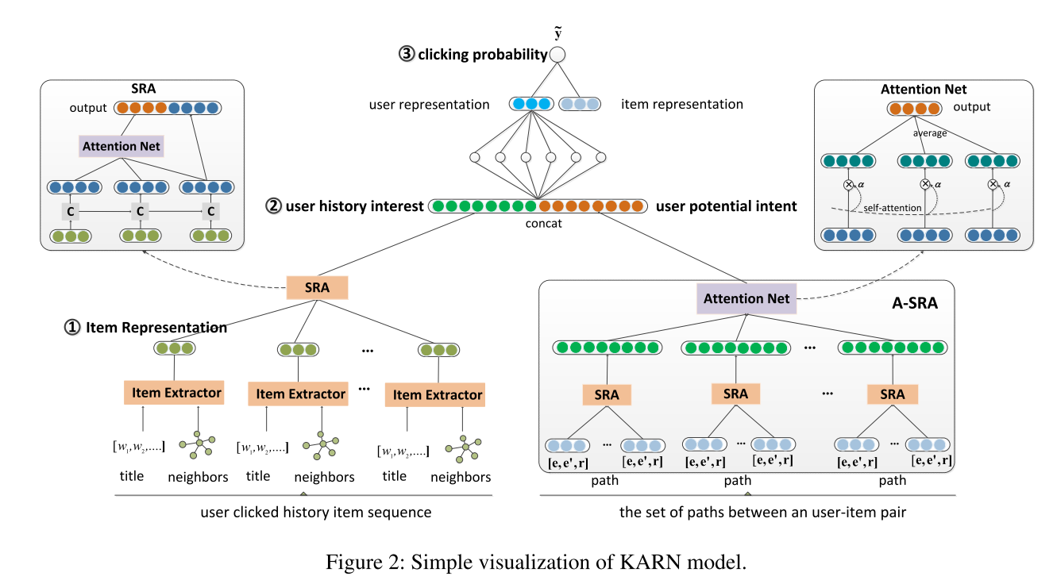
Approach

Slide 6
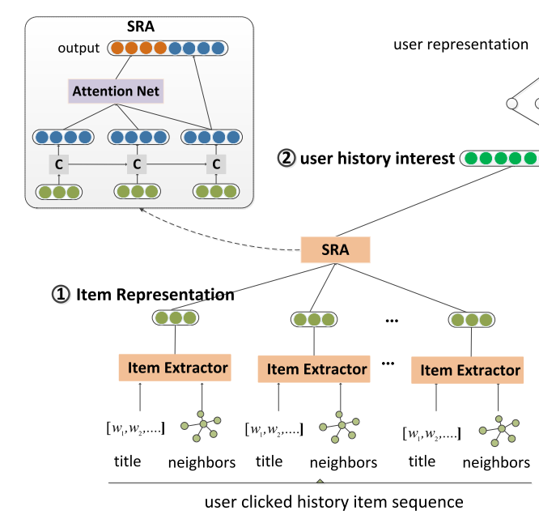
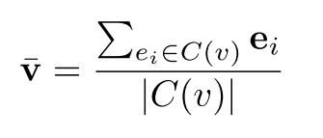
Approach
$p_{i}=$max-pooling($m_{i}$)
$g_{2}$ is the transformation function.

Slide 7
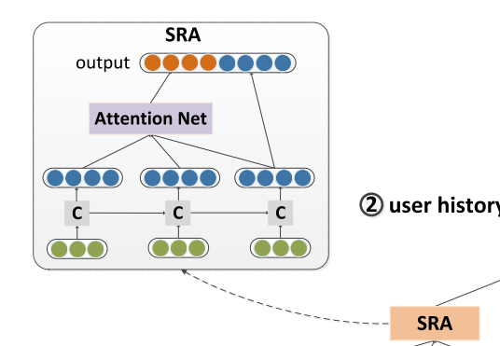
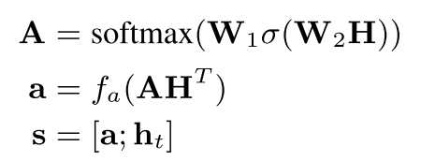
Approach
User’s History Interest Extraction:
Input of LSTM

Slide 8
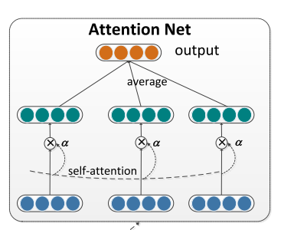
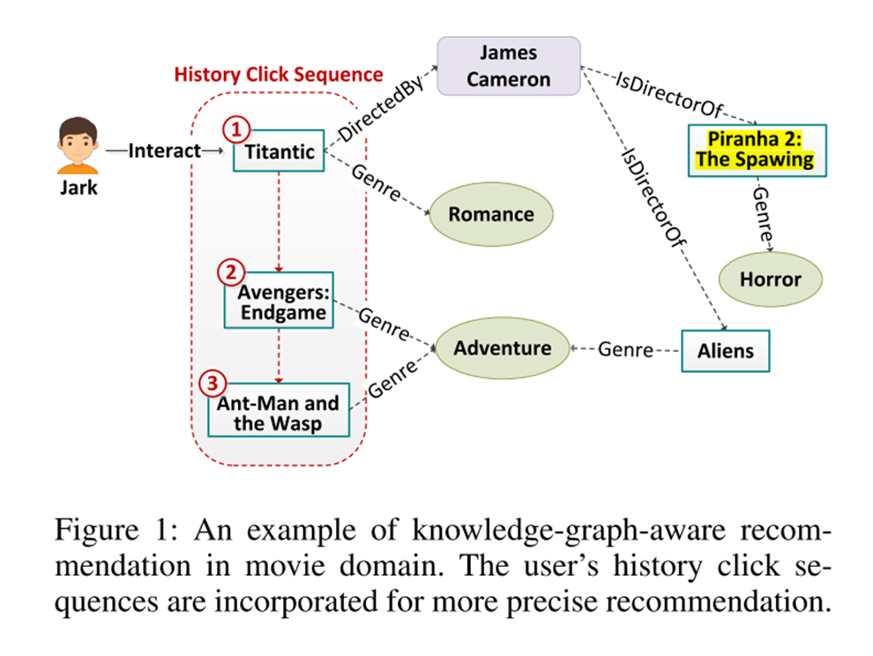
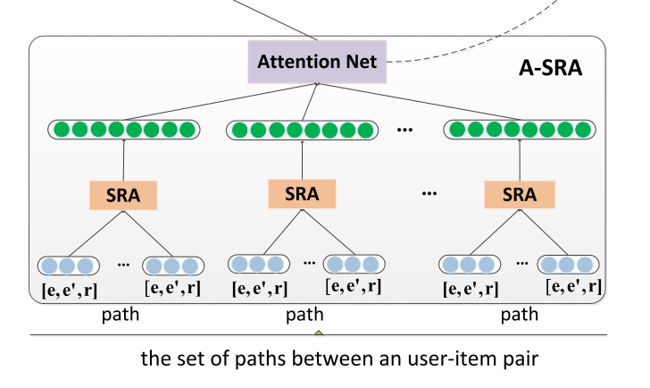
Approach
如上图，e是指实体Titantc,$e^{′}指$Titantic的类型是Romance,Tiantic与下一个实体的关系是r
是一条路径

Slide 9
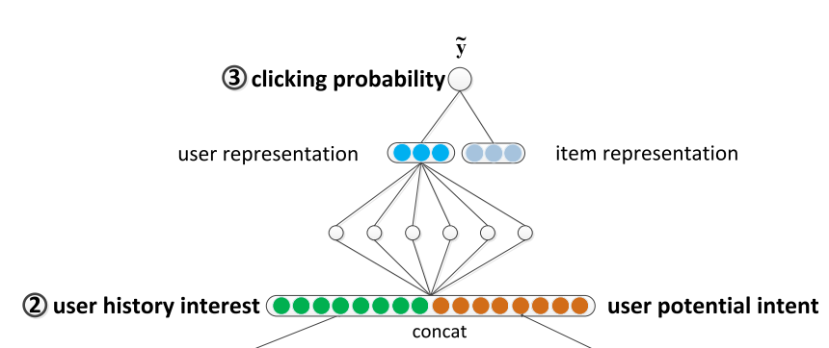
Approach

Slide 10
Approach
Loss function：

Slide 11
Experiments

Slide 13
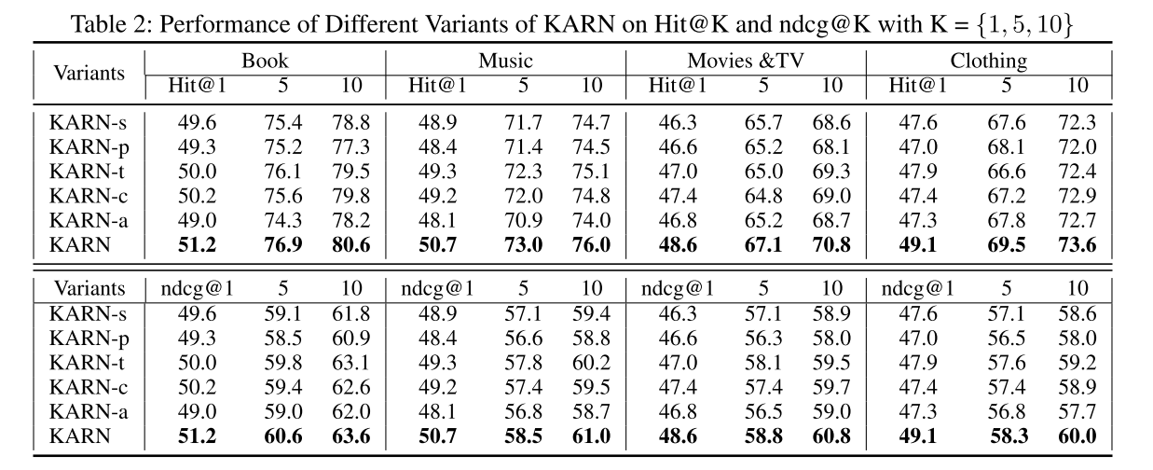
Experiments

Slide 14
Conclusion
The user‘s historical click sequence information is useful.
The experimental results demonstrate that our model KARN has achieved state-of-the-art recommendation performance.

Slide 15
Thanks

